Slide 1
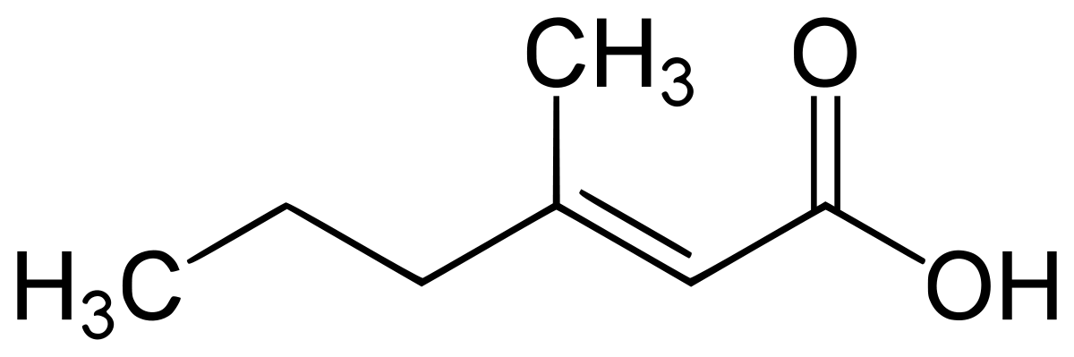
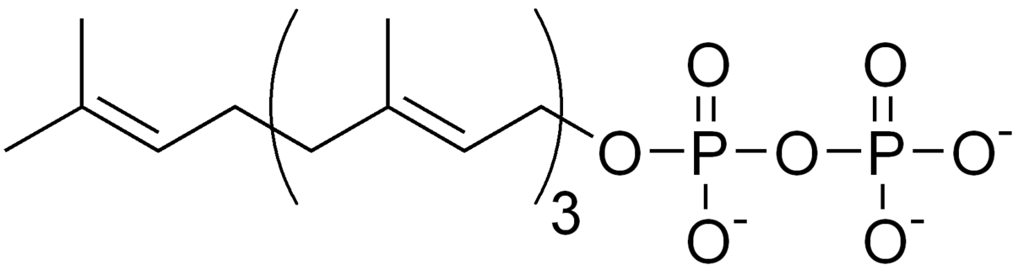
Extraction of
Biosynthetic Pathways
from Images
Anubhab Chakraborty

Slide 2
Overview
A typical research paper of our interest
Goals for pyamiimage
Running Tesseract OCR on png image
Generating SVG from Tesseract OCR
Phrase detection
Phrase annotation
Contextual arrows for chemical reactions
Extracting arrows from biosynthetic pathways
Adding contextual arrows to SVG
Where to find us

Slide 3
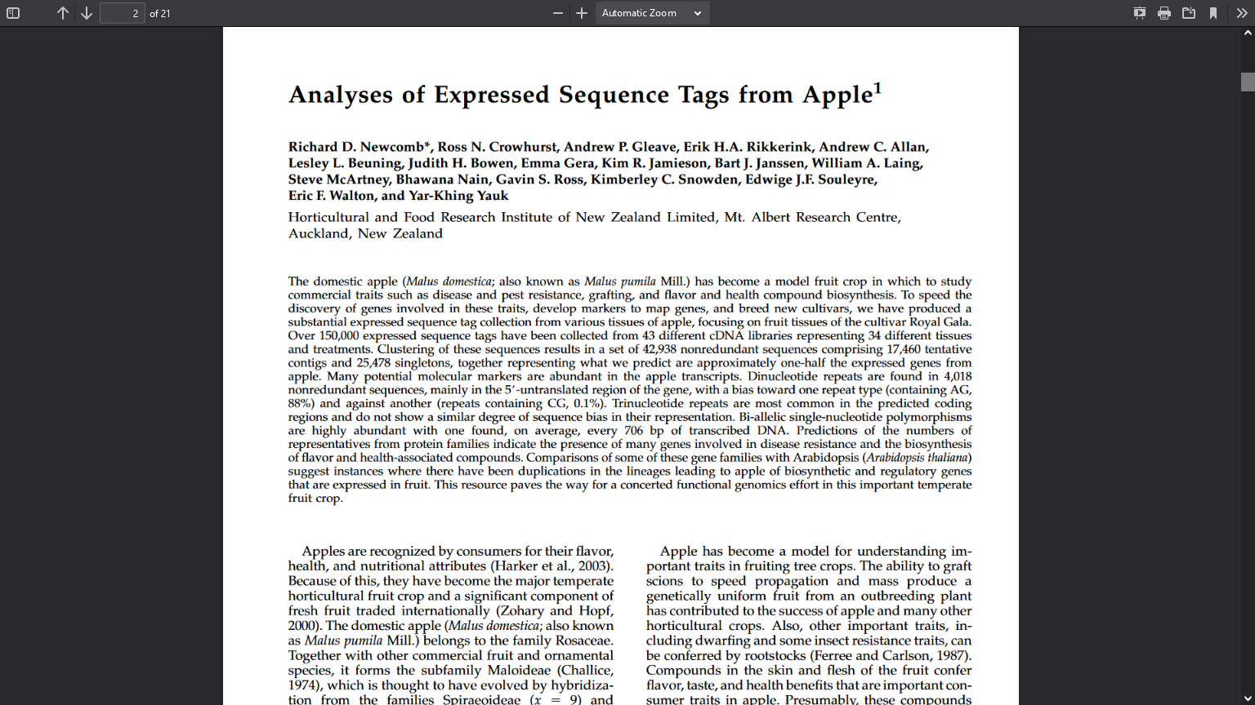
A typical biosynthetic research paper

Slide 4
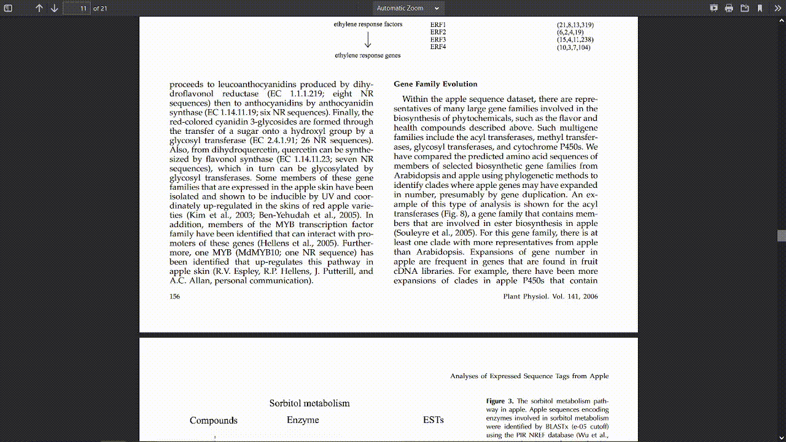

Slide 5
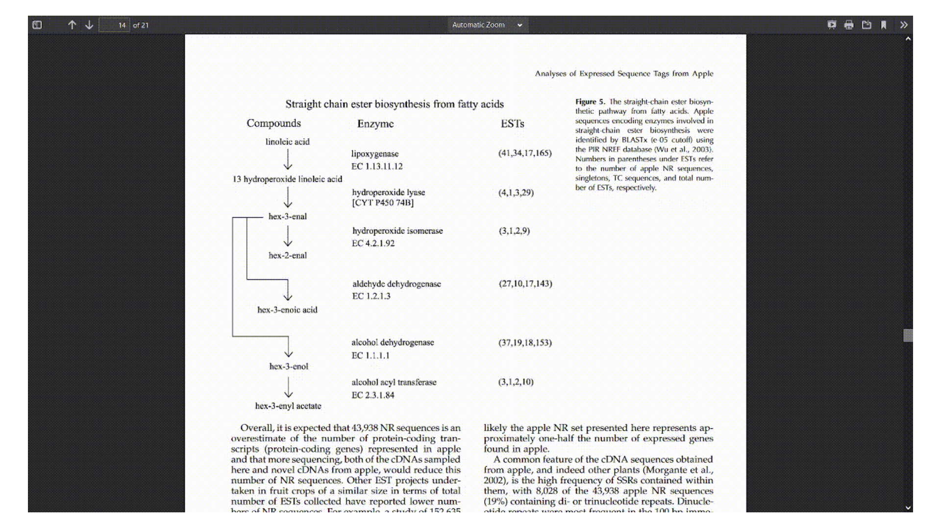

Slide 6

Goal
Useful scientific information is often locked up in images in scientific papers
Currently you need a human to read and interpret the diagrams
Our goal with pyamiimage is to read such images and extract useful semantic information from the images automatically!
Right now we are working on biosynthetic pathways
IMAGE

Slide 7





IMAGE
CML
Chemical Markup Language

Slide 8
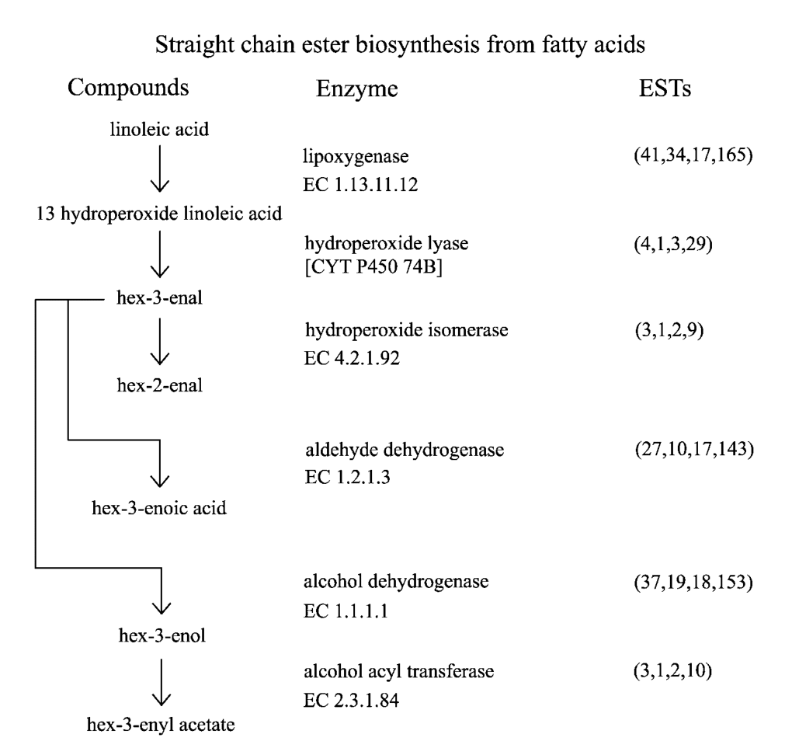
PNG
A biosynthetic pathway image found in literature
This is a DUMB document
Just pixels, only humans can read and understand it
Let’s try to make it smarter
Extract text with Tesseract

Slide 9


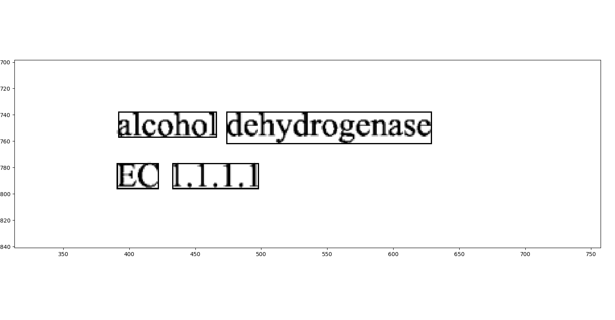
tesseract-ocr / tesseract
<span class="ocr_line" id="line_1_25" title="bbox 392 738 629 762; baseline 0 -5; x_size 24; x_descenders 5; x_ascenders 6"> <span class="ocrx_word" id="word_1_45" title="bbox 392 738 466 757; x_wconf 96">alcohol</span> <span class="ocrx_word" id="word_1_46" title="bbox 474 738 629 762; x_wconf 96">dehydrogenase</span> </span>

Slide 10
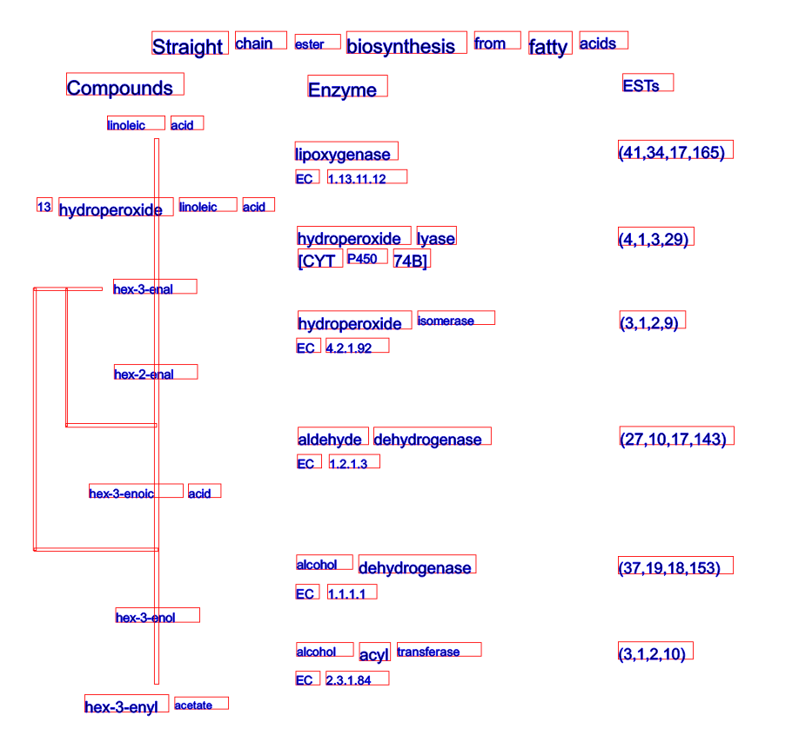
SVG
PNG
SVG from Tesseract output
Tesseract recognises text in the whole image

Slide 11
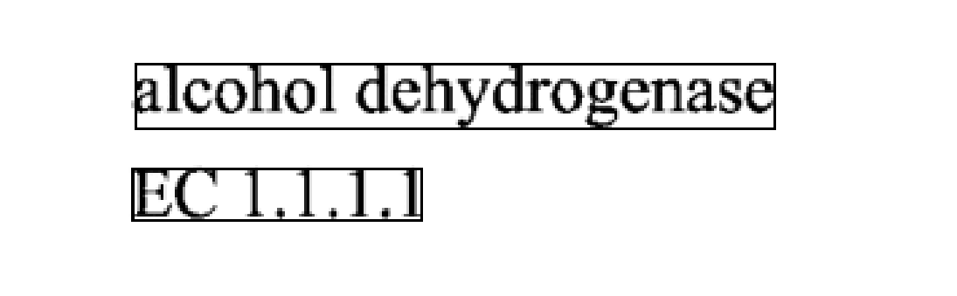
Geometric Phrase Detection
Words:
IMAGE
Phrases:

Slide 12



Wikidata/KEGG/PubChem Lookup
IMAGE
Wikidata
https://www.wikidata.org/wiki/Q410754
KEGG
https://www.genome.jp/entry/1.1.1.1

Slide 13
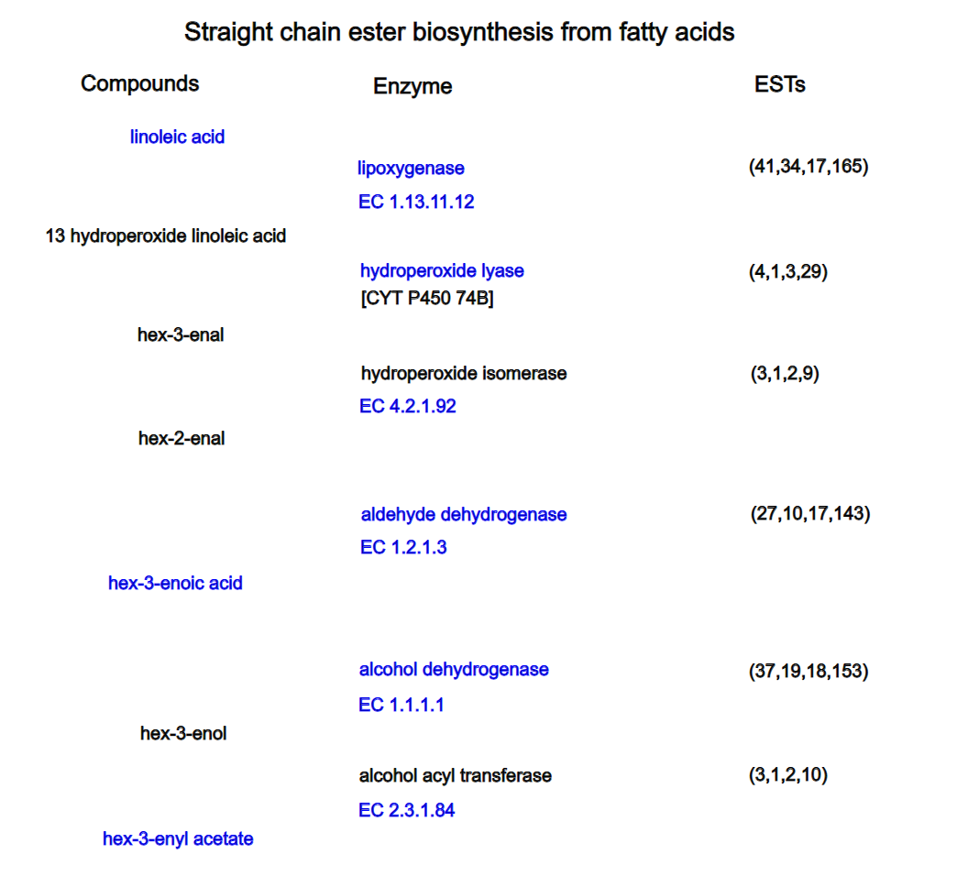
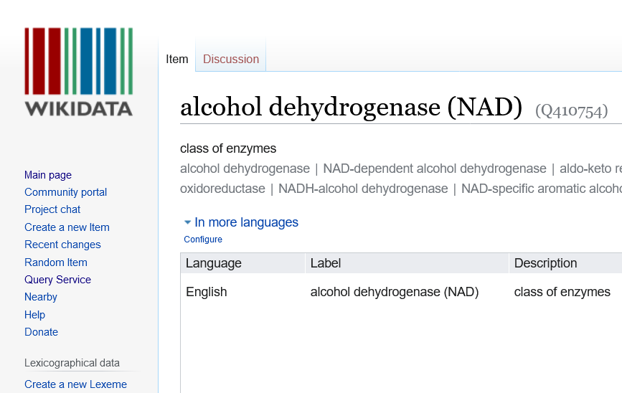
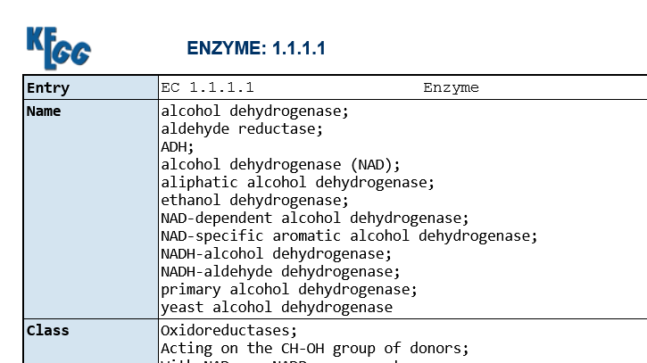
Automatic hyperlinks
SVG

Slide 14
Arrows in Pathways
Substrate
Tail of the arrow
Enzyme
Perpendicular to the arrow shaft
We add context to the arrows
Product
Head of the arrow

Slide 15
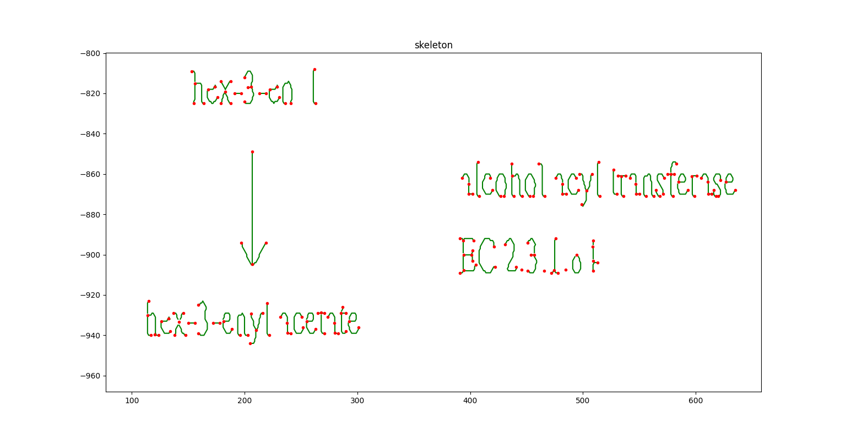
Invert ~> Binarize ~> Skeletonize skimage + Image-Py / sknw
IMAGE
Geometric
Arrow detection

Slide 16
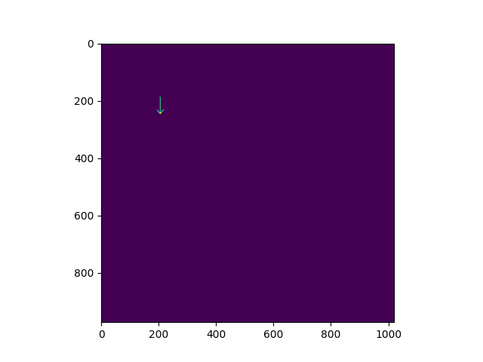
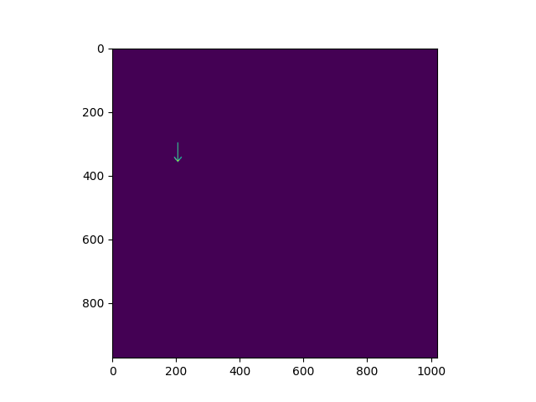
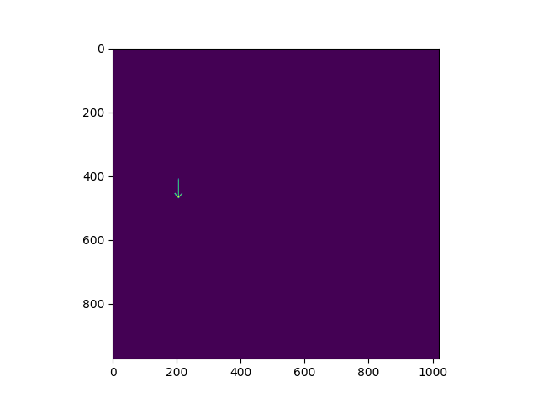
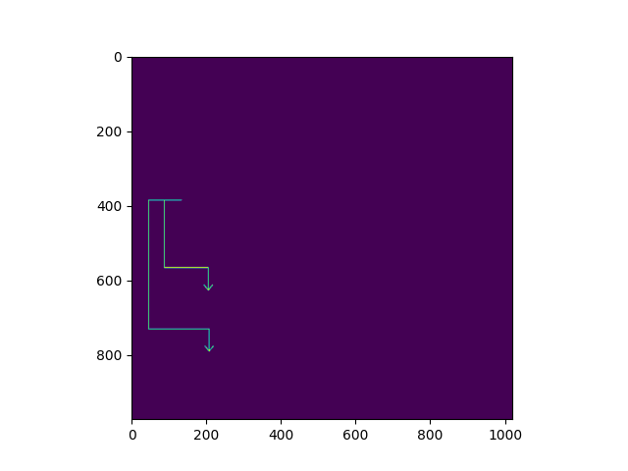

Automatic detection of Arrows

Slide 17
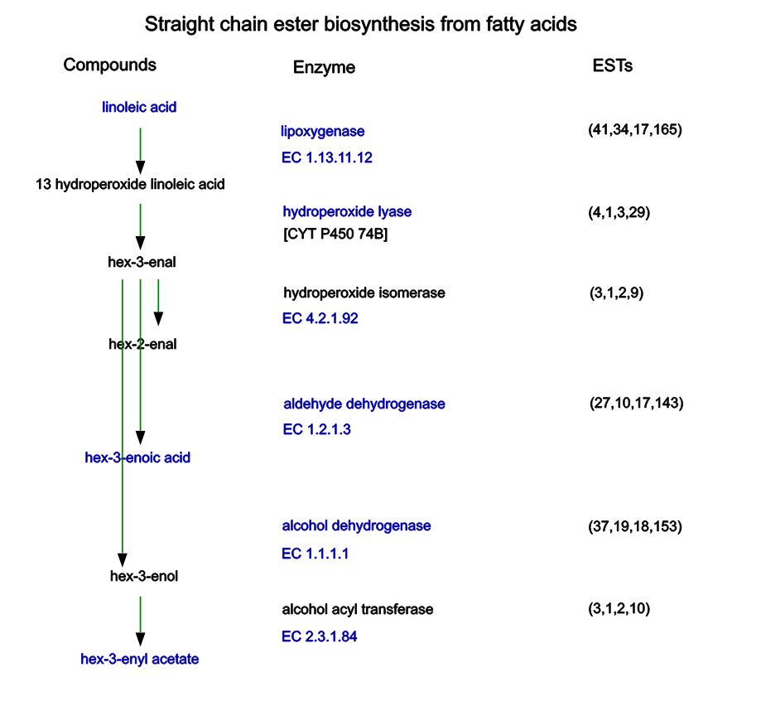
SVG with links embedded in the text and arrows
Conversion to CMLReact
will be automatic

Slide 18

The code for
can be found in:
Thank you for listening!
Find us in Github
Github: @anuvc
IMAGE
https://github.com/petermr/pyamiimage

Slide 19
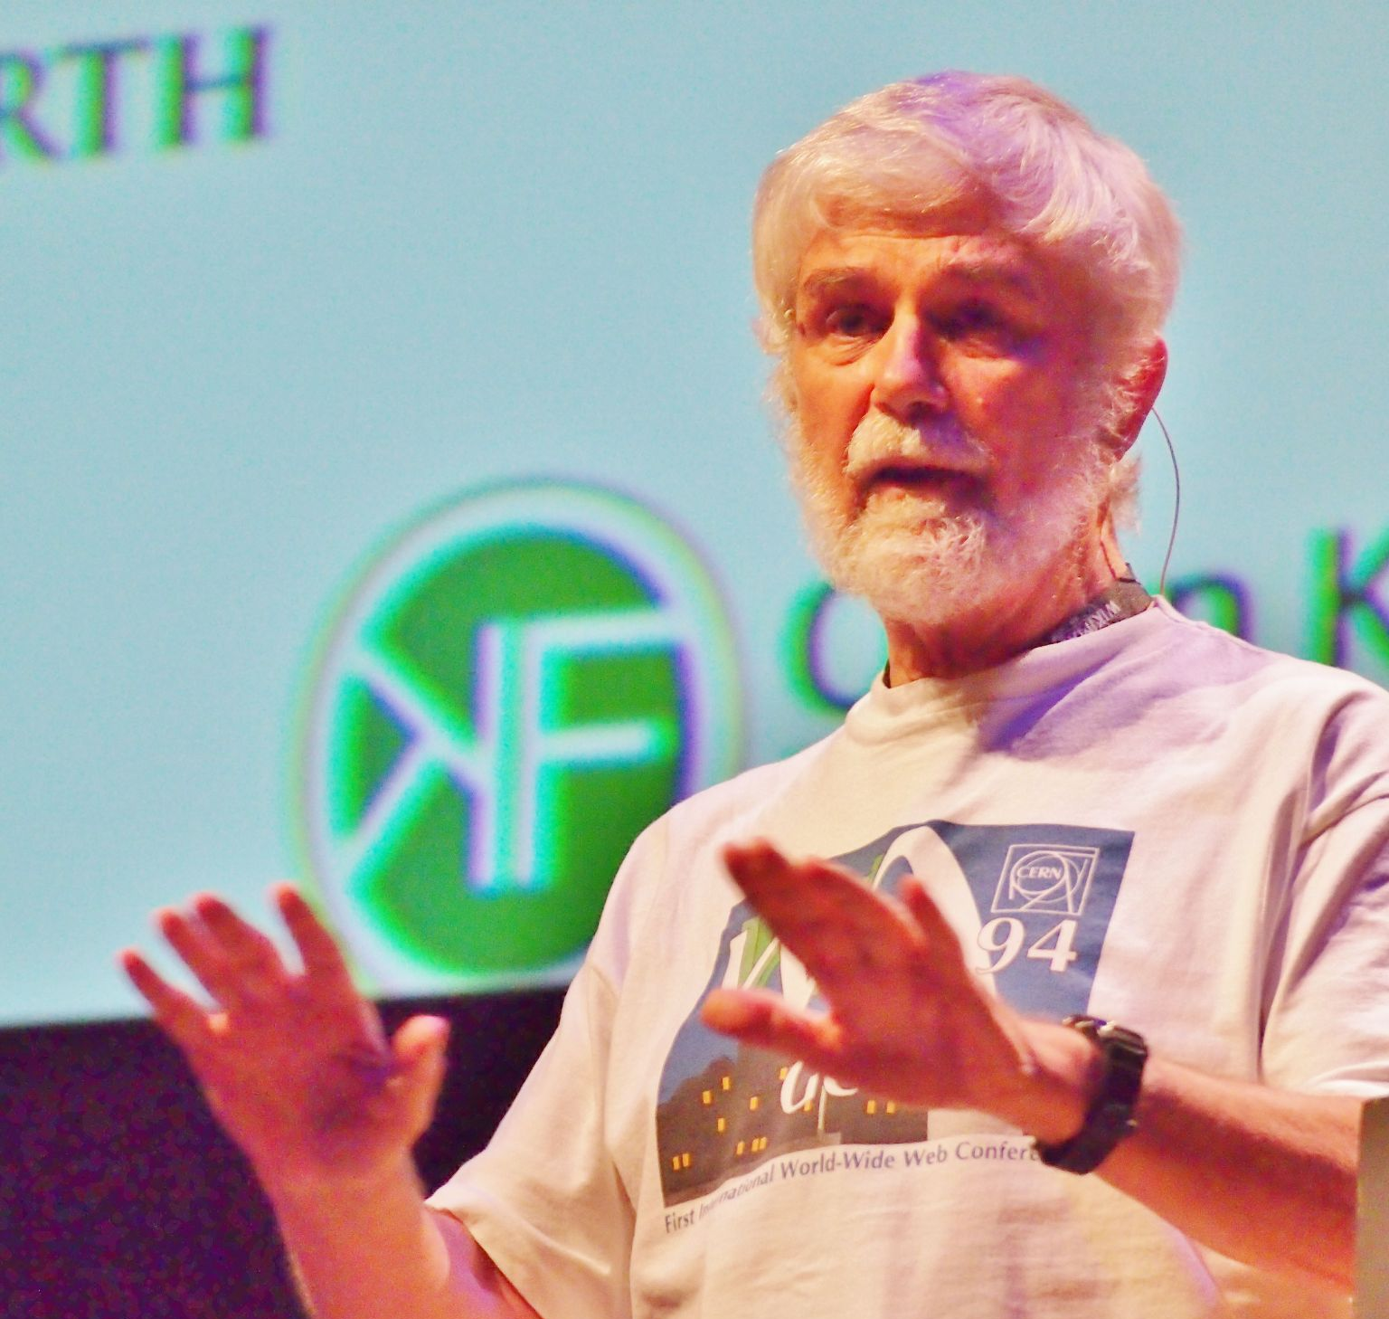

Thanks to my mentors!
Dr. Peter Murray-Rust
Dr. Gitanjali Yadav
Github: @petermr
Github: @gilienv

